Slide 1


SESSION 3.2
Re-ranking & Context
Optimization
Building the production-grade "Extract Once, Judge Many" pipeline using Two-Stage Retrieval and Contextual Compression.

Slide 2


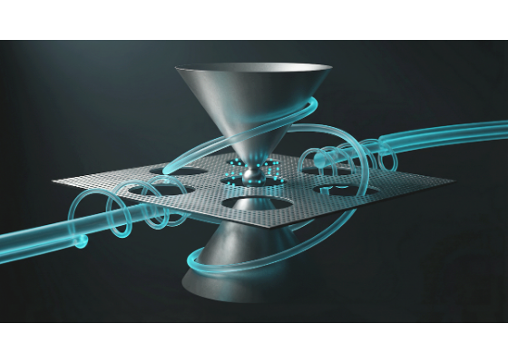
Course Overview & Agenda
01 The Bi-Encoder Ceiling Identify the mathematical limitations and inevitable information loss of standard vector databases (The Net).
02 Enter the Cross-Encoder Leveraging deep attention mechanisms as a "Heavyweight Judge" (The Scalpel) to evaluate contextual chemistry.
03 Two-Stage Retrieval Pipeline Architecting the enterprise funnel: high recall base retrieval combined with rigorous, absolute precision re-ranking.
04 Contextual Compression Trimming the fat by physically slicing irrelevant sentences out of chunks to maximize efficiency and minimize cost.

Slide 3



The Bi-Encoder Ceiling
Strict Separation
The Illusion of Accuracy
Models like GoogleGenerativeAIEmbeddings and OpenAI's text-embedding-3 use a Bi-Encoder architecture.
In Week 2, we built a FAISS database. It is blisteringly fast, searching millions of chunks in milliseconds. It feels like the ultimate search engine.
The Hard Truth: FAISS is fast, but it is fundamentally mathematically flawed when it comes to deep grammatical nuance.
A Bi-Encoder works by strictly separating the Query and the Document. They never actually "see" each other until the final Cosine calculation.

Slide 4







Bi-Encoder Mechanics
How the standard LangChain retrieval process actually works under the hood:
1. Ingestion (Offline)
2. Search (Online)
3. Comparison
The network reads a corporate PDF chunk. It compresses the entire meaning into a single 768D vector and saves it to FAISS.
The network reads the user's prompt. It compresses the prompt into a completely separate 768D vector.
A basic algorithm (Cosine Similarity) calculates the mathematical angle between the two independent vectors.

Slide 5



The Compression Bottleneck
Information Loss is Inevitable
Imagine taking a dense, 500-word paragraph detailing a highly complex server architecture failure, complete with specific error codes, author names, and timestamps.
Loss of Direction
You force the embedding model to compress all of that rich, grammatical nuance into exactly 768 numbers.
Compression destroys the subtle directional relationship between words in a sentence.

Slide 6

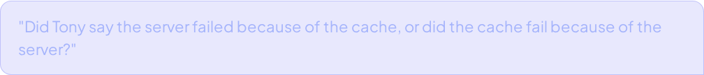


The Directional Failure
Now, the user asks a tricky, nuanced question:
Nuance Destroyed
Topics Captured
Because it compresses the entire sentence into one point in space, FAISS will proudly return ANY document containing those 4 words, completely ignoring the actual cause-and-effect relationship requested.
When the Bi-Encoder converts this question into 768 numbers, it accurately captures the overarching "topics": Tony, Server, Cache, Failure.

Slide 7




The Classic NLP Edge Case
Because of heavy compression, Bi-Encoders suffer from severe "bag-of-words" blindness.
Query A
Query B
"How to get a work visa for Canada from the United States."
"How to get a work visa for the United States from Canada."
To a human, these are complete opposites. To a Bi-Encoder, the vocabulary is 100% identical. The vectors stack on top of each other. FAISS will fail.

Slide 8


The Net vs The Scalpel
The Heavyweight Judge
Does this mean FAISS is useless?
We cannot trust the top 3 results from FAISS for a strict "Extract Once" pipeline.
Absolutely not. Bi-Encoders have one massive advantage: Speed. Because document vectors are pre-computed in RAM, you can search 1 billion documents in 10 milliseconds.
Before handing chunks to the generative LLM, we need a Scalpel to inspect them, score them flawlessly, and throw away the garbage.
FAISS is the Net. We cast it wide to catch the top 30 roughly relevant chunks instantly.
Enter the Cross-Encoder.

Slide 9



Architecture of True Comprehension
A Cross-Encoder does not use Cosine Similarity. It Abandons the Bi-Encoder's "blind matchmaking" for the raw, uncompressed power of the Transformer's Full Self-Attention Mechanism.
Simultaneous Input
You do not embed the query and document separately. You concatenate them into a single, massive string of text, separated by a special classification token.
[CLS]
[SEP]
[SEP]
The neural network reads this entire string at the exact same time.

Slide 10



The Cross-Attention Matrix
Why It Works Flawlessly
Inside the layers of the Cross-Encoder, every single word mathematically "looks" at every other word to establish context.
The word "rate" in the question looks specifically at the number "15%" in the document.
The word "OCR" binds directly to "scanners".
Attention Crossover
The model perfectly understands directional grammar, solving the Canada/US visa edge case.

Slide 11



The Output Score
After reading the combined text, the Cross-Encoder does not generate a conversational answer. It outputs a single, highly precise floating-point number (a logit score).
0.01
0.99
Garbage Match
Perfect Match
The document absolutely does not answer the user's specific question.
The document is a flawless, undeniable factual match for the question's exact intent.

Slide 12


The Latency Nightmare
The $O(N)$ Computation
Time Complexity Comparison
If Cross-Encoders are so brilliant, why don't we use them to search all 1 million corporate PDFs?
FAISS Search: ~5 milliseconds
With a Cross-Encoder, you cannot pre-compute anything. The interaction depends entirely on the specific combination of the exact query and the specific document.
Cross-Encoder Search: ~45 minutes of heavy GPU compute time.
It is physically impossible to use it as a primary search engine.
You must run a full neural network forward pass 1,000,000 times for a single search.

Slide 13



Industry Standard Models
Because Cross-Encoders are strictly used for evaluation rather than massive retrieval, they are typically much smaller models than generative LLMs.
Open Source Local
Proprietary Cloud APIs
The undisputed king is the ms-marco family by Microsoft (cross-encoder/ms-marco-MiniLM-L-6-v2).
For massive enterprise deployments, companies use APIs like Cohere (rerank-english-v3.0) or Voyage AI.
Small enough to run entirely on a local CPU, but punches way above its weight class in scoring accuracy.
You send the query and the candidate documents to their servers, and they return the sorted array instantly.

Slide 14




The Ultimate Analogy
The Blind Matchmaker
The Dinner Date
Bi-Encoder (FAISS)
Cross-Encoder
Looks at two separate profiles, sees you both like "Python", and declares a match in 1 second. Fast, but often wrong.
Puts the Query and Document in the exact same room, forces them to talk, and evaluates their actual chemistry. Flawlessly accurate.

Slide 15


The Enterprise Funnel
In software engineering, when you have two tools with opposite strengths and weaknesses, you don't choose between them. You chain them.
To build a production-grade pipeline, we architect a Two-Stage Retrieval Pipeline. This mimics how massive commercial search engines (like Google or Bing) process queries.
They don't use their heaviest AI models to search the entire internet; they use a funnel to narrow down the noise.

Slide 16

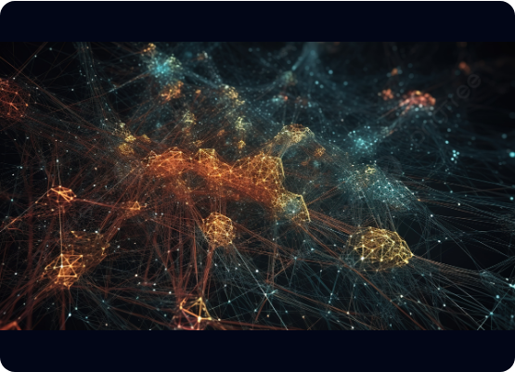
Stage 1: Base Retrieval (The Net)
The Goal: High Recall. We guarantee the correct answer is somewhere in the results, even if buried under garbage.
Hit the FAISS database (Bi-Encoder).
Open the floodgates: retrieve k=25 chunks instead of just 3.
Blazing fast: takes only 5-10 milliseconds.
The result: We have 25 chunks. Most are irrelevant, but the actual perfect chunk is hiding in there (e.g., at Rank #18).

Slide 17

The "Lost in the Middle" Risk
If we fed all 25 rough chunks directly to the LLM right now, the immense noise would trigger the dreaded "Lost in the Middle" hallucination phenomenon. We must ruthlessly filter them.

Slide 18









Stage 2: Re-ranking (The Scalpel)
High Precision
Heavyweight Judge
Controlled Latency
The goal flips from recall to precision. We take the 25 rough candidates from Stage 1 and evaluate them rigorously.
We use a Cross-Encoder. It concatenates the query with each chunk and runs a deep neural forward pass to output a relevance score.
Because we only run the Cross-Encoder 25 times (instead of 1,000,000), computational latency is drastically reduced to ~100-200ms.

Slide 19
The Final Truncation (Top-K Cutoff)
1. Sort by New Scores Once the Cross-Encoder has scored all 25 chunks, the array is sorted in descending order based on their true semantic relevance.
2. Promote the Winner A chunk that was originally buried at Rank #18 by the Bi-Encoder can now be ripped from the bottom and promoted to the absolute #1 position.
3. Strict Cutoff Apply a strict Top-K Cutoff. Throw away the bottom 22 chunks and only keep the Top 3 pristine, flawlessly vetted chunks to inject into the Mega-Prompt.

Slide 20
The Latency vs. Accuracy Trade-off
Pipeline Stage | Technology Used | Core Function | Approx. Latency
Stage 1 | FAISS (Bi-Encoder) | High Recall Search (k=25) | ~10ms
Stage 2 | Cross-Encoder | Re-rank top 25 chunks | ~150ms
Stage 3 | Gemini LLM | Generative Answer generation | ~1500ms
For a mere 150ms penalty, we transform a blind vector search into a system that physically comprehends the grammatical relationship between query and document before bothering the LLM.

Slide 21
Contextual Compression: Trimming the Fat
The "Needle in a Haystack" at the Chunk Level
96%
Even the 3 winning chunks have hidden inefficiencies. If our chunks are 1,000 characters long, but the factual answer is only 40 characters...
We are forcing the LLM to read through 960 characters of useless filler (lunch schedules, unrelated milestones) just to find a 40-character fact.
Useless Token Noise
We pay for every garbage token, and it increases hallucination risks.

Slide 22
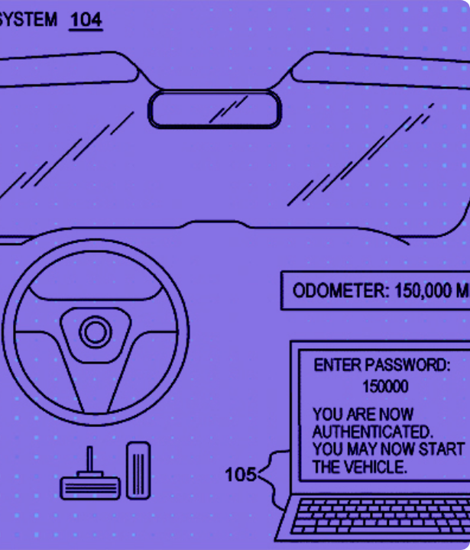
The Compression Laser
We must stop treating chunks as immutable blocks of text.
We need a system that physically slices the chunk open, extracts ONLY the sentences relevant to the user's query, and throws the rest in the trash before it hits the Mega-Prompt.
If the Cross-Encoder is a "Scalpel", the Contextual Compressor is a "Laser" burning away bad sentences inside good chunks.

Slide 23


LangChain Compressor Types
Compressor A:
LLMChainExtractor
Compressor B:
EmbeddingsFilter
Maximum Precision
High Speed
Uses a small, fast LLM (like Gemini Flash) with a hidden prompt to physically read the chunk and extract exact answering sentences.
Dynamically splits chunk into sentences, embeds each, and filters them against the query using a strict Cosine Similarity threshold (> 0.85).
Trade-off: High precision, but severe latency and cost. 3 chunks = 3 separate LLM extraction calls.
Trade-off: Lightning fast (sub-millisecond embedding APIs), but relies entirely on Bi-Encoder math accuracy.

Slide 24









The Textbook Highlighting Analogy
1. Base Retrieval
2. Cross-Encoder
3. Compression
Finding the 20 general books in the massive library that merely mention the word "Budgets".
Selecting the 3 absolute best, most relevant books from that pile and throwing the remaining 17 away.
Taking a yellow highlighter, marking only the specific sentences that answer the question, and ripping those pages out for the CEO.

Slide 25


The MLOps Reality: When to Compress?
Massive Models (Gemini Pro)
Efficient Models (Gemini Flash)
Features an industry-leading 1M-2M token context window.
Ideal for "Extract Once, Judge Many" tasks processing thousands of documents.
Near-perfect needle-in-a-haystack recall out of the box.
To keep costs low, we use incredibly fast, cheaper models.
The model can handle the "fat". Compressing 3,000 tokens down to 300 might be over-engineering.
Compression ensures the cheap, fast LLM only ever sees 100% pure, unadulterated facts.

Slide 26






Initializing the Two-Stage Retriever
1. The Net (FAISS Base)
2. The Scalpel (Cross-Encoder)
3. The Compressor Wrap
Initialize FAISS.load_local and configure the Base Retriever.
Wrap the FAISS base retriever inside a ContextualCompressionRetriever.
Download ms-marco-MiniLM-L-6-v2 directly from HuggingFace, specifically trained for relevance scoring.
We cast a wide net to pull the top 20 candidates (k=20) in milliseconds instead of just 3.
The unified retriever is now ready to query, slice, and re-rank the document chunks on the fly.
Configure CrossEncoderReranker to score all 20 but ONLY return the best 3 (top_n=3).

Slide 27

Wiring the LCEL Pipeline
The final step is wiring our brand new, highly accurate compression_retriever into our standard LCEL flow.
1. Search FAISS pulls 20 initial chunks.
2. Re-rank Cross-Encoder compresses down to 3 chunks.
3. Generate Feeds the 3 pristine chunks to Gemini 2.5 Flash via a PromptTemplate.
Pipeline Success: 20 chunks retrieved, 17 discarded, 3 injected, 0 hallucinations.

Slide 28
Thank You.
Ready to build wildly accurate, highly cost-efficient RAG pipelines?
Session 3.2 Complete • MLOps Engineering Track

